Slide 1
OVERVEIW: PROCESS-BASED GEOLOGIC MODELS
EXPEC Advanced Research Center, Geology Technology Division
Aramco Upstream Solution Technathon October 26-28, 2018

Slide 2
Outline
Basic concepts on hydrocarbon reservoirs.
Process-based geologic modeling.
Process-based geologic modeling workflows.
Challenges in process-based geologic modeling.
Future roadmap.

Slide 3
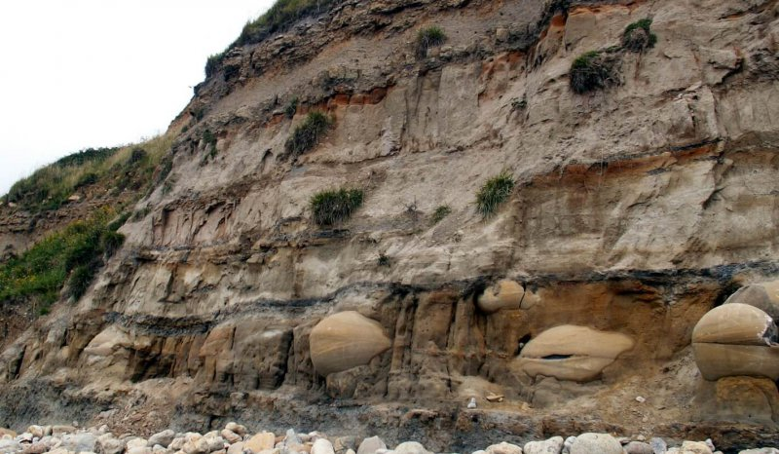
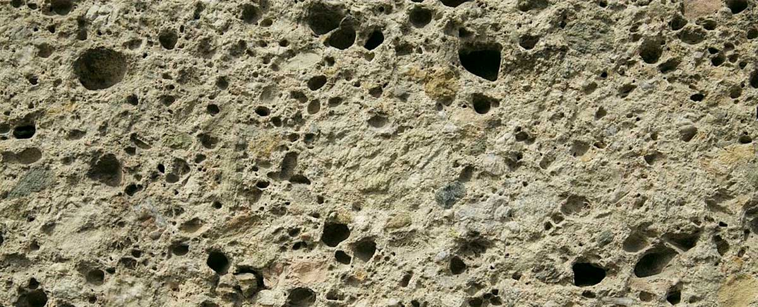
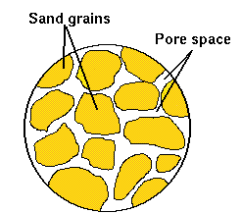
Rocks Containing Hydrocarbons
Aggregates of solid fragments with voids in between.
Oil is hosted in rocks
Rocks have voids
Porosity

Slide 4
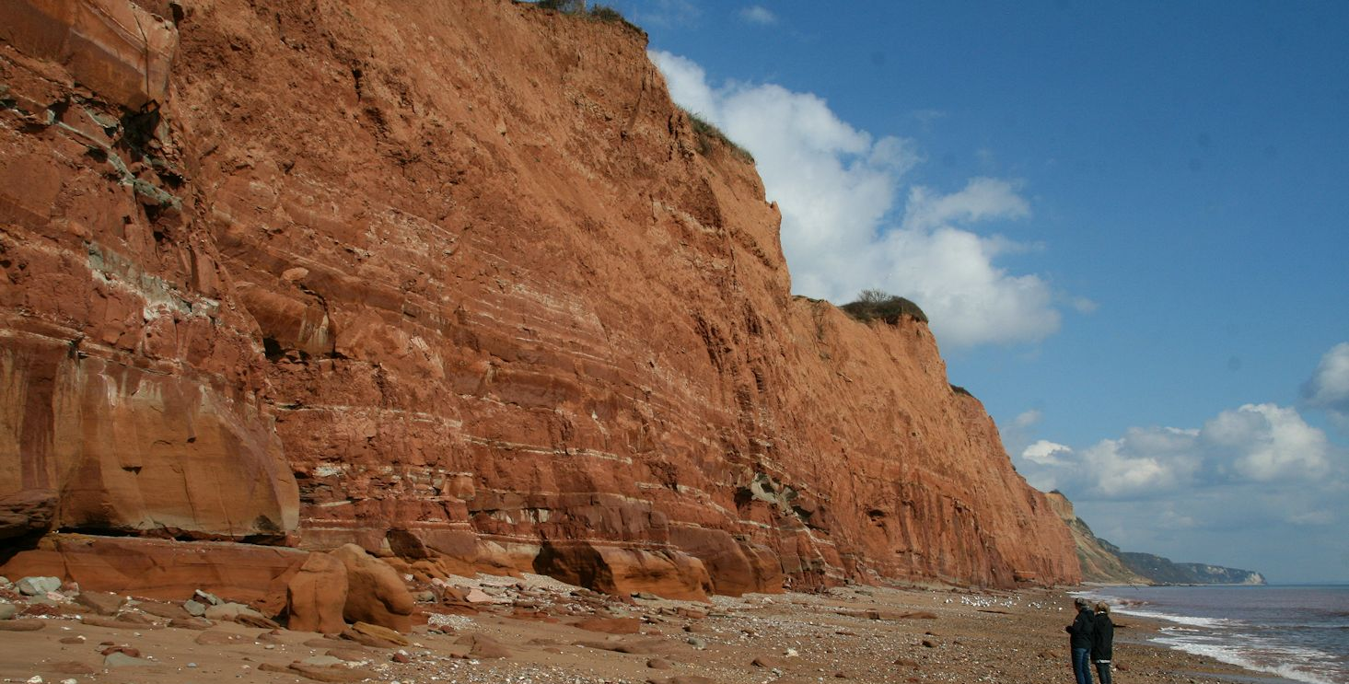
Hydrocarbon in the Subsurface
Accumulations of hydrocarbon are found in layers of porous rocks known as reservoirs.

Slide 5
Characterizing Hydrocarbon Reservoirs
Successful production of hydrocarbons requires characterizing the reservoirs.
Reservoir Characterization
Architecture
Quality
Rock types & their spatial extent
Pore volume & pore connectivity (permeability)

Slide 6
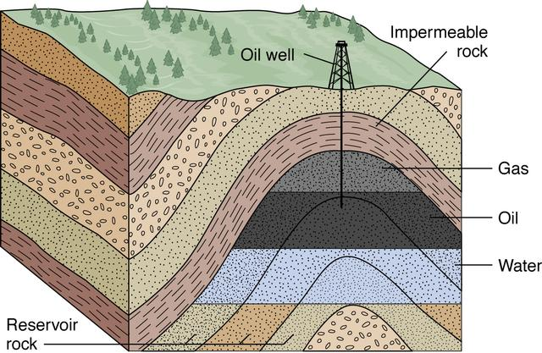
Business Impact of Characterizing Hydrocarbon Reservoirs
Robust Reservoir Characterization
Enhanced Recover and Discovery of Hydrocarbons
Where to drill wells ?

Slide 7
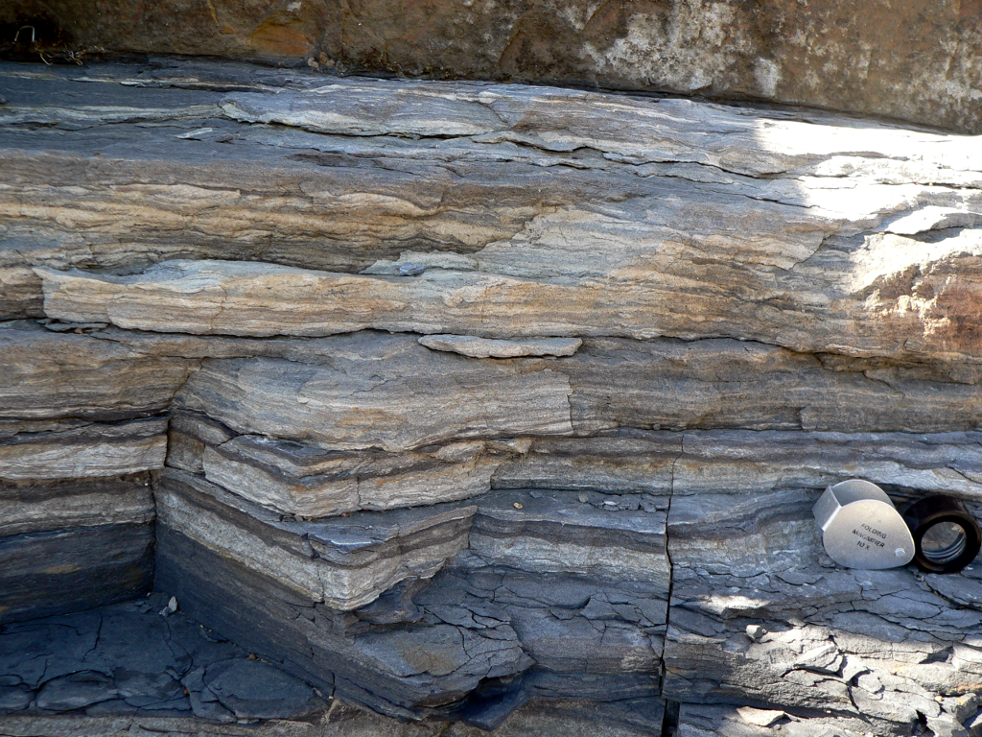
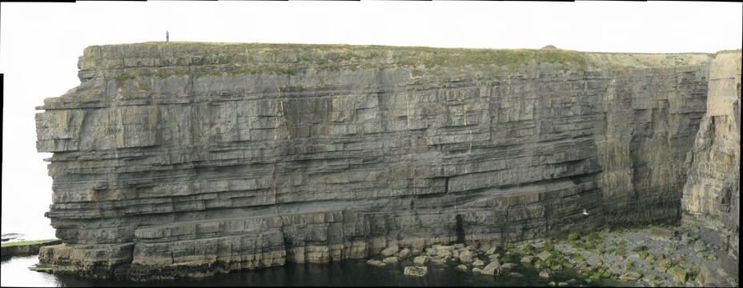
Challenges in Characterizing Hydrocarbon Reservoirs
Hydrocarbon reservoirs are inherently heterogeneous.

Slide 8
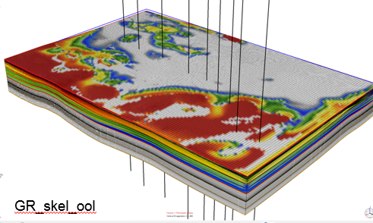
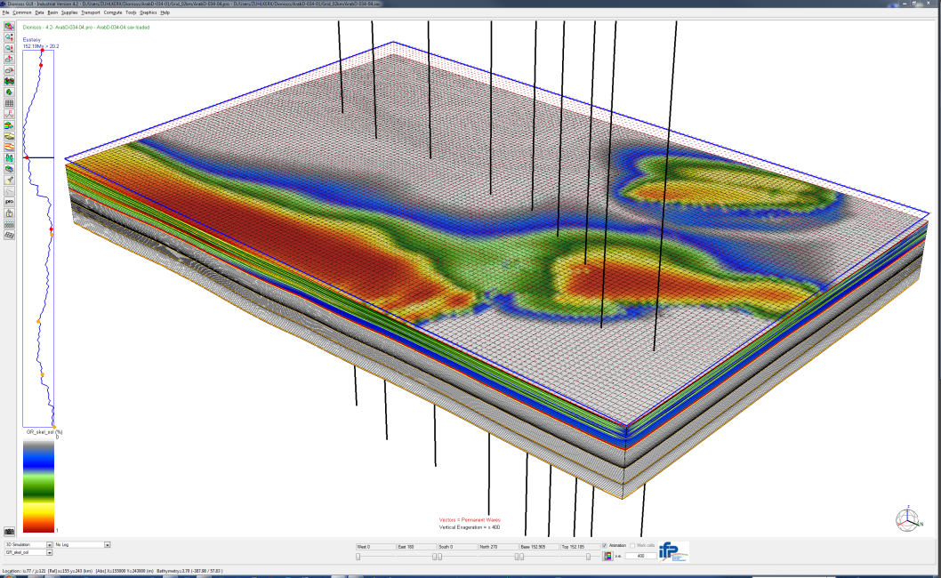
Geologic Models
Numerical representations of rock types or corresponding physical properties.
Vertical and horizontal directions (2D/3D).
Computational way to characterize and visualize hydrocarbon reservoirs.
Rock Type
A
B
C
D

Slide 9

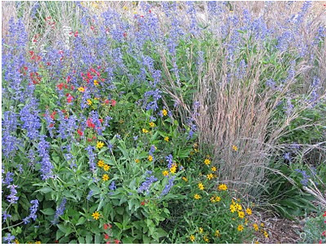


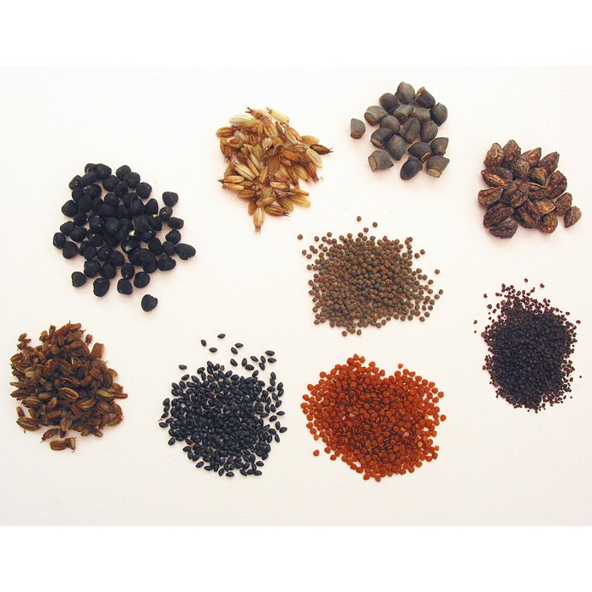
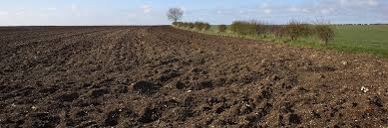

Approaches of Geologic Modeling
Inverse approach: sensing physical characteristics remotely (uncertain)
Forward modeling approach: the present is the key to the past
describing interaction of the constituents of a product (less uncertain)

Slide 10
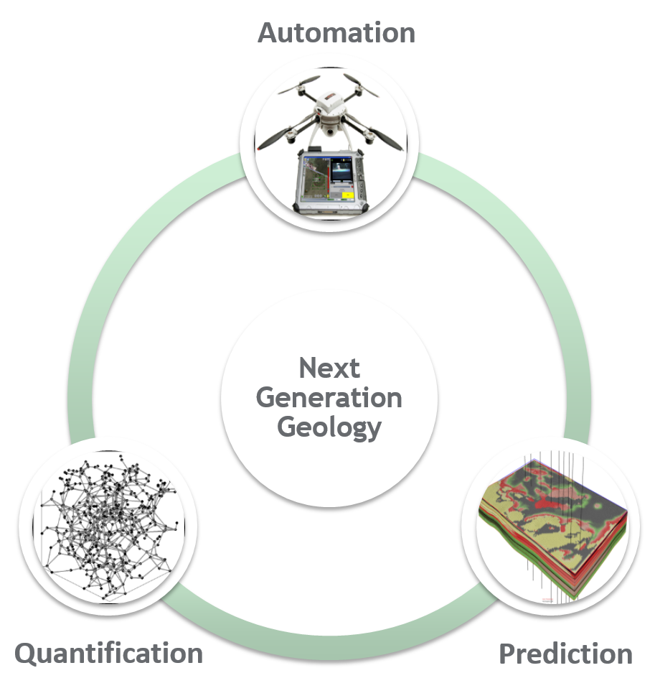
Our Vision: Next Generation Geology
Geologic Processes
Porosity and Permeability

Slide 11
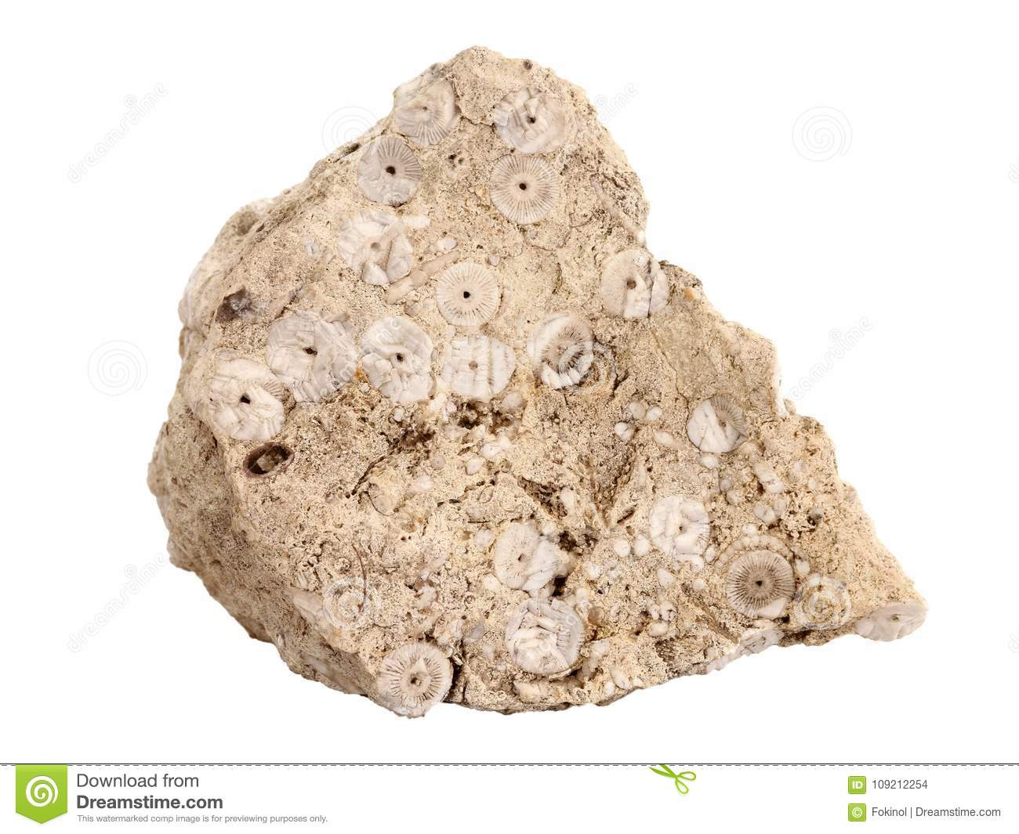
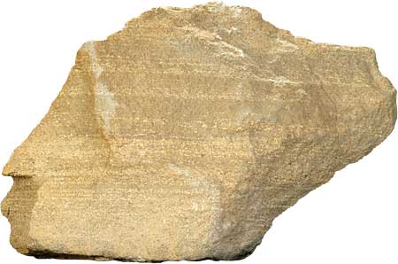
Deposition
The process of aggregating the rock fragments to form rocks.
Facilitated by different depositional systems (e.g., winds, water or glaciers).
Different depositional systems deposit different rocks.
Carbonate
Sandstone

Slide 12
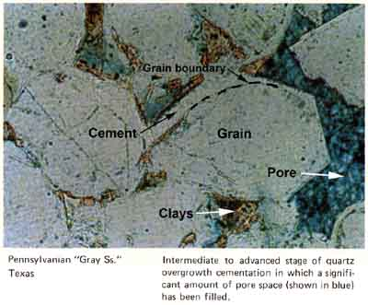
Diagenesis
Chemical alteration of rocks after deposition.
Changing in the physical properties such as porosity.
Differing for different rock types.

Slide 13
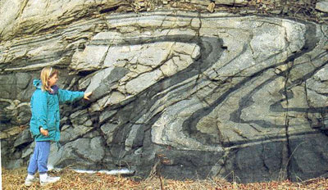
Geomechanics
Stress variations in the subsurface.
Deforming the original shape of deposited layers.
Controlling porosity (e.g., through fracturing).

Slide 14

Process-Based Geologic Modeling
Depositional
Diagenetic
Geomechanical
No
Solving for the physics
*Calibration Data
Predicted porosity and permeability
Final model of porosity and permeability
Yes

Slide 15
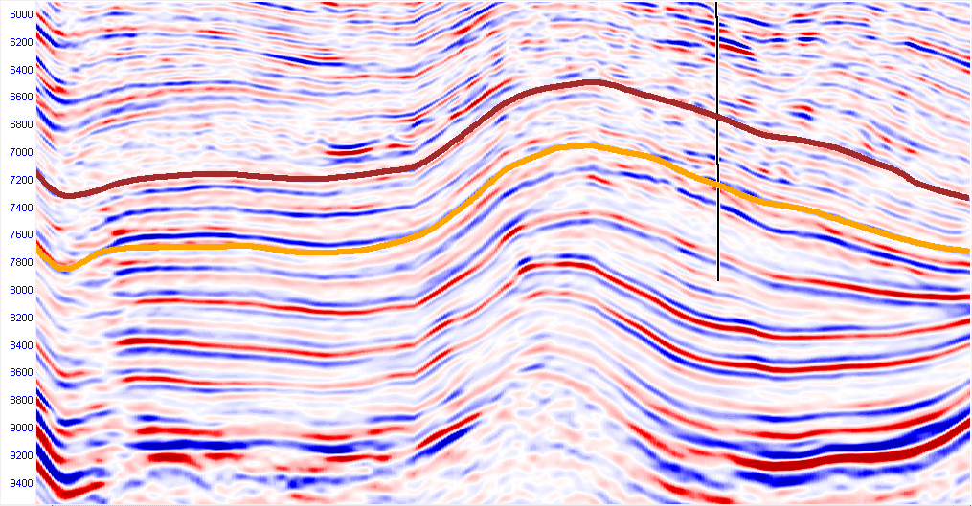
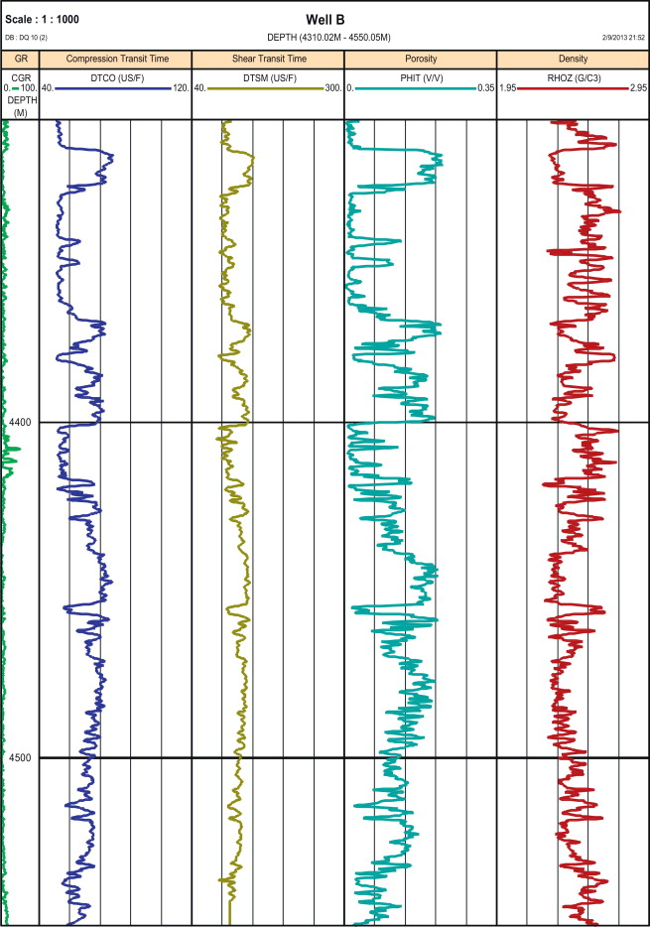
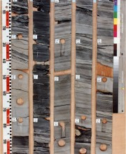
Subsurface Data for Process-Based Geologic Modeling
Seismic data: images of the subsurface based in reflection of seismic waves and travel time.
Well log data: measurements of physical properties of the rocks in a penetrated wellbore.
Core samples: cylindrical sections of rocks in a penetrated wellbore.
Seismic Data
Well Log
Core

Slide 16
Constructing Process-Based Geologic Models
Inputs to describe the layers and their physical properties spatially.
Inputs related to the geologic processes in the past.
Integrating data of different scales.
Solving coupled equations of the physics of the system.
Seismic Data
spatially extensive; coarse resolution 15-30 m
Well Log Data
Spatially limited; fine resolution 15 cm

Slide 17
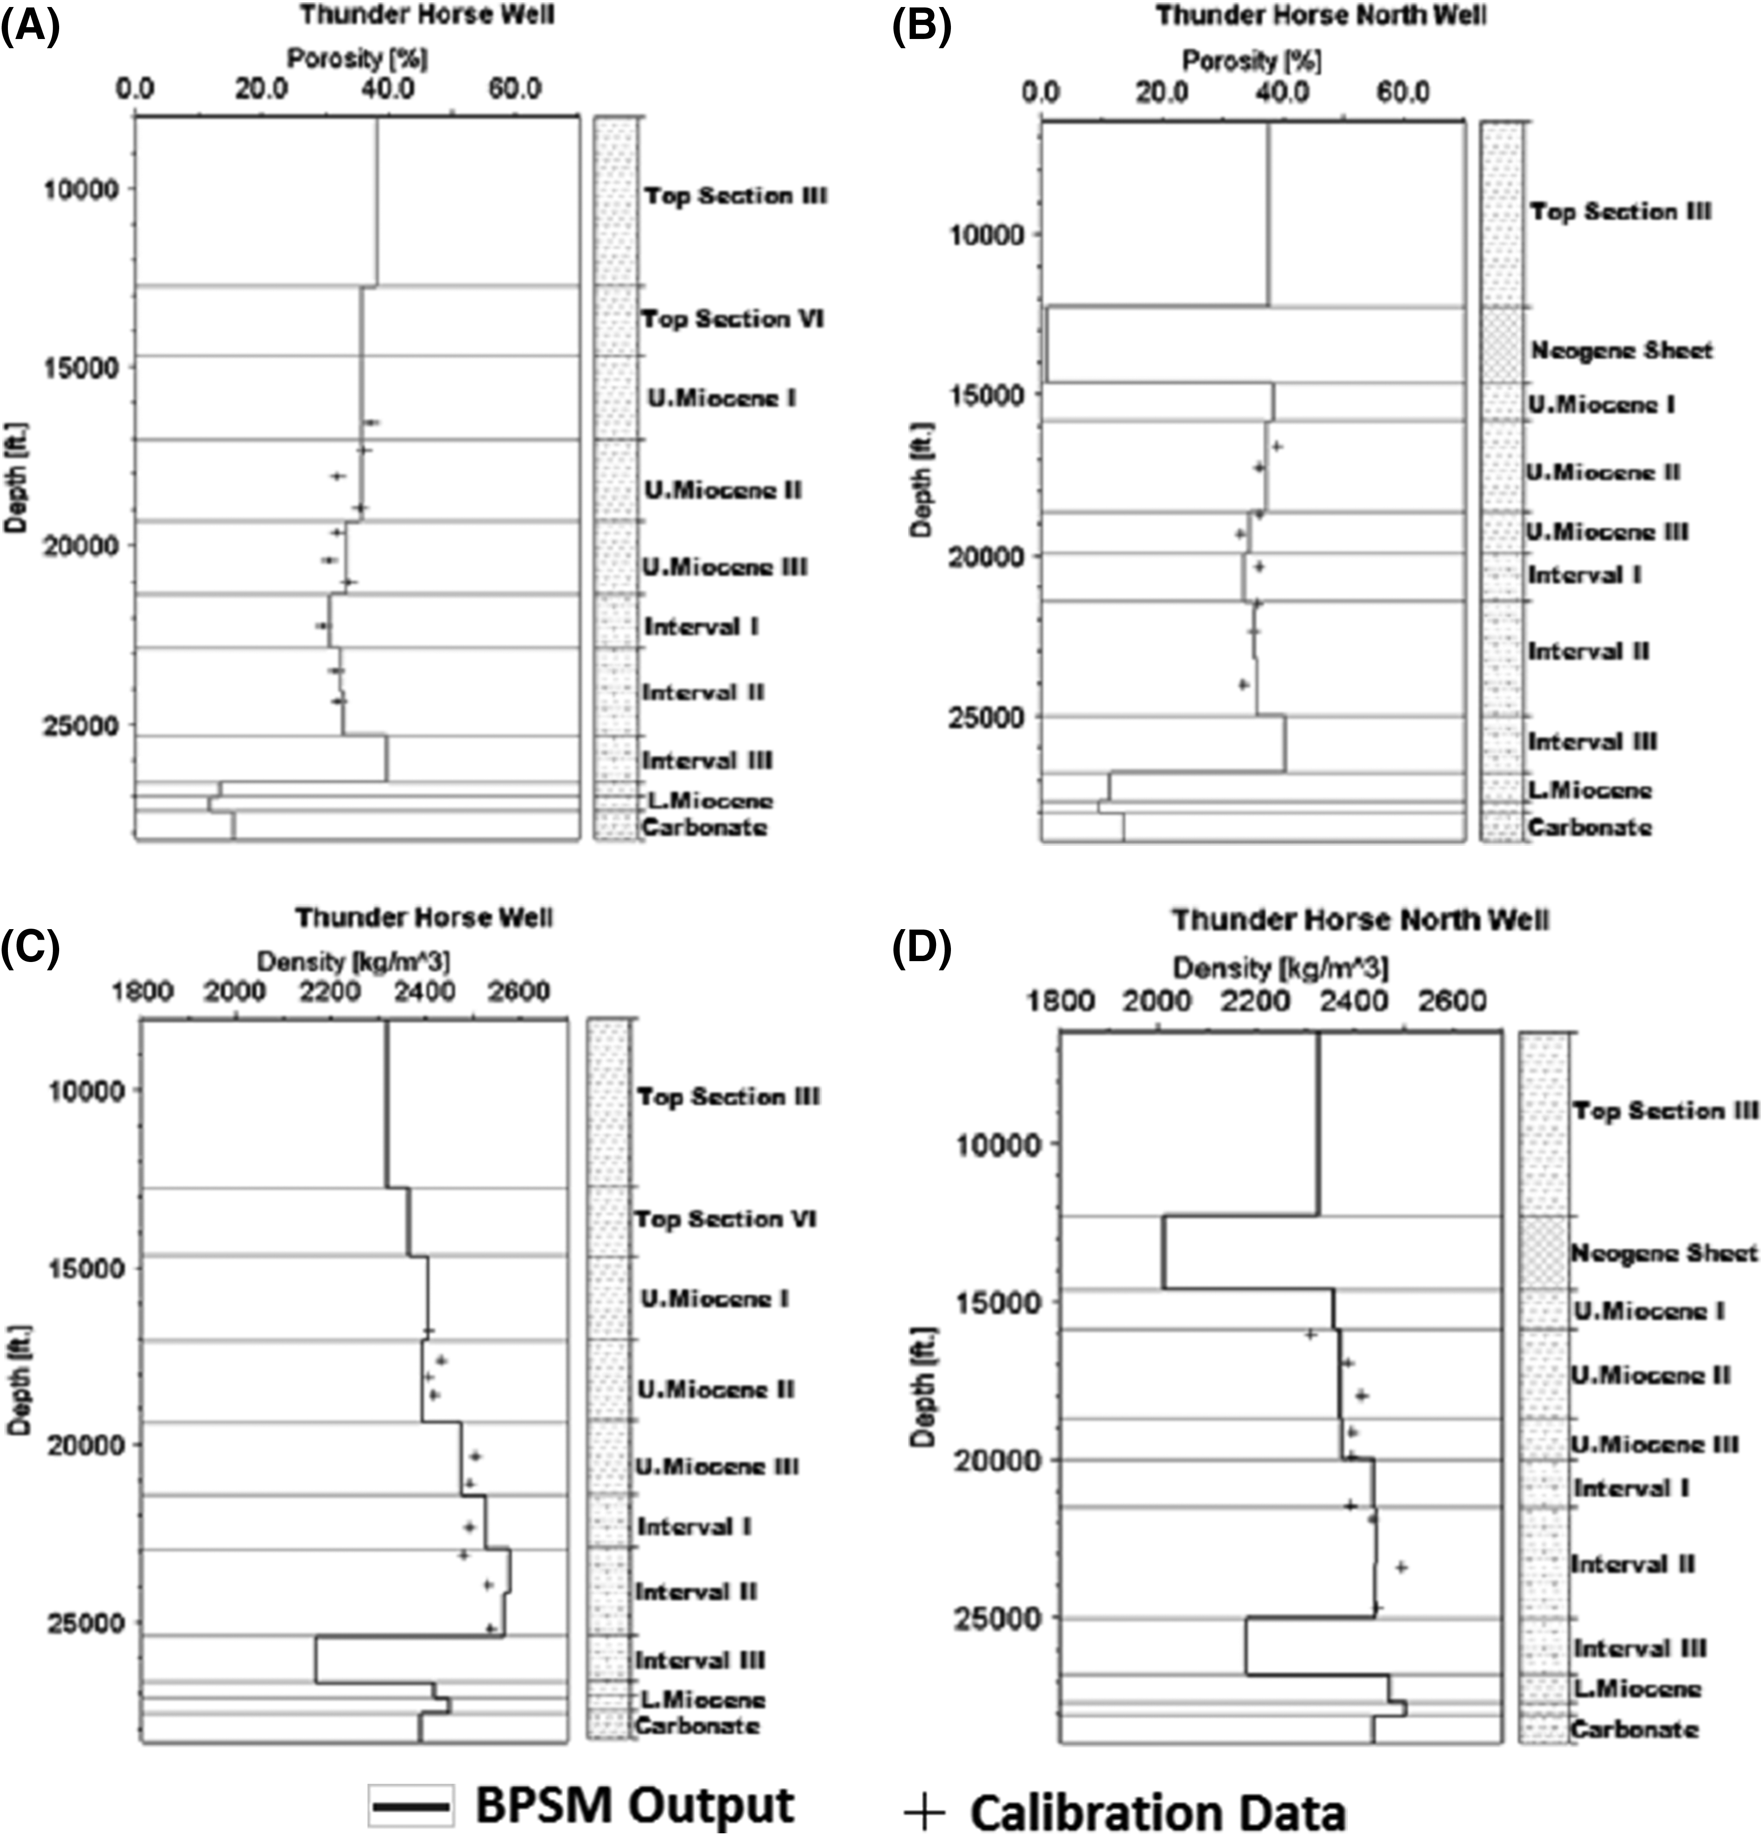
Calibrating Process-Based Geologic Models
Comparing models with available data (i.e., various types of data).
Giving validity to models.
Requiring iterative adjustment of model parameters.

Slide 18
Challenges in Process-Based Geologic Modeling
Many manual inputs including:
Maps (e.g., layers geometry)
Rock properties
Parameters related to geologic processes
Boundary conditions (e.g., sea level in geologic time)
Sparse calibration data at different scales:
Wells and core data (spatially limited, high vertical resolution)
Seismic data (spatially continuous, low vertical resolution)

Slide 19
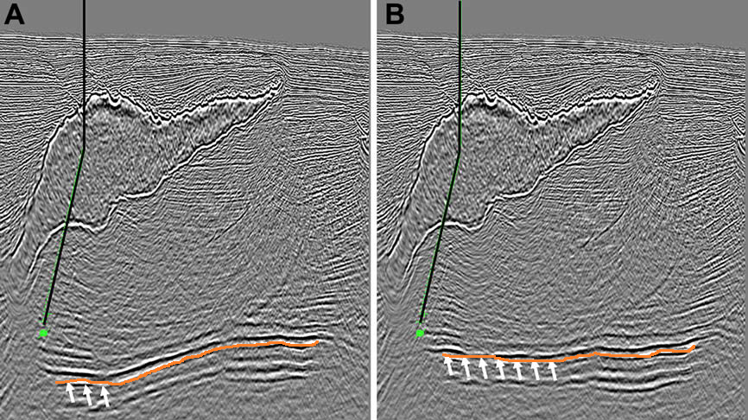
Challenges in Process-Based Geologic Modeling
Time consuming process that demands manpower:
Many manual inputs
Computationally demanding simulation
Iterations are typically necessary for calibration
The models are associated with inherent uncertainty:
Input parameters related to the geologic history
Uncertainty in present day data (e.g., seismic depth maps)
10000
20000
Depth (ft)
30000
40000
Velocity Model I
Velocity Model II

Slide 20
Challenges in Process-Based Geologic Modeling
Integration of various models.
Depostional Modeling
Diagenetic Modeling
Process-Based Geologic Modeling
Platform
Geomechanical Modeling
Calibration

Slide 21
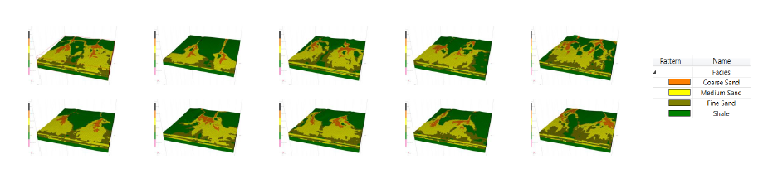
Next: Automate Integrated Process-Based Geologic Models
Constructing Models
Constructs new models with already established workflows.
Calibrating Models
Calibrates existing models constantly to acquired data.
Integration
Integration of different geological models.
Performing sensitivity analysis
Test model sensitivity to certain input parameters.

Slide 22
Rewards
Efficiency
Reducing manpower
Accelerating processes in exploration
Lowering risk
Making models more robust
Improving plans for exploration and
development
Quantifying uncertainties

Slide 23

For any questions:
Wisam.kawai@Aramco.com
Lama.abualsaud@Aramco.com

